Slide 1
Lecture 1.4 ConceptS: costs and profiT

Slide 2
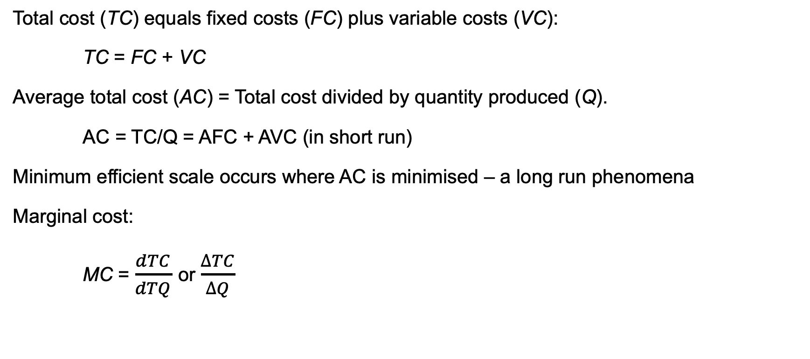
costs
Total cost (TC) equals fixed costs (FC) plus variable costs (VC):
TC = FC + VC
Average total cost (AC) = Total cost divided by quantity produced (Q).
AC = TC/Q = AFC + AVC (in short run)
Minimum efficient scale occurs where AC is minimised – a long run phenomena
Marginal cost:
MC = $\frac{dTC}{dTQ}$ or $\frac{∆TC}{∆Q}$

Slide 3
$
If MC > AC, AC is rising
If MC < AC, AC is falling
If MC = AC, AC is minimised
Marginal cost
Average cost
min AC
0
Q
0
q*

Slide 4
profit
Accounting statements focus on historical costs. Given the need to provide objective, verifiable numbers to external audiences, this makes sense.
But you do not want to make decisions based on accounting costs. Economic costs, which include the opportunity costs of deploying resources to another activity, must also be considered.
This difference between economics and accounting costs leads to a difference between economic and accounting profit.

